Slide 1
Introduction to Bayesian Analysis
Sandersan Onie
PhD Candidate, UNSW Sydney, School of Psychology

Slide 3


BACKGROUND
Indicate orientation with
EMOTION-INDUCED BLINDNESS
Most, Chun, Zald & Widders, 2005
Notes:
So here’s what a typical trial looks like. In a stream of images, a target image will be rotated 90 degrees, to the left or the right. All you need to do is indicate in which direction the target image is rotated.

Slide 4
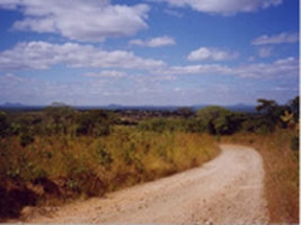
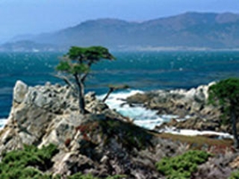





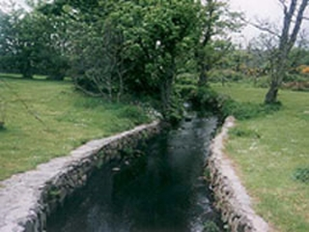
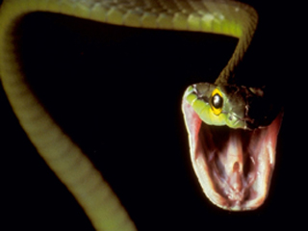
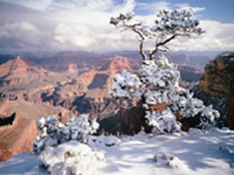



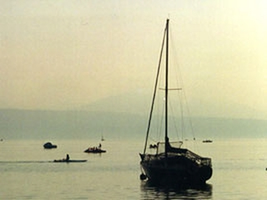
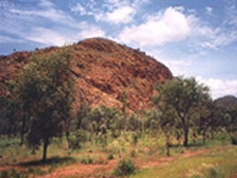
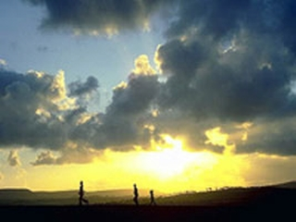




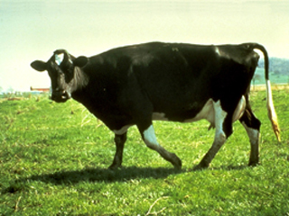
BACKGROUND
EMOTION-INDUCED BLINDNESS
Most, Chun, Zald & Widders, 2005
Notes:
Alright, let’s begin.
Trial Commences
Which direction was the image rotated?
Alright, let’s try that again
Which direction was the image rotated?
How many of you saw the snake?

Slide 5
Part 1: Why Learn Bayes?
Introduction to Bayesian Analysis

Slide 6
Hagger et al., 2016
Notes:
Ego Depletion – entire rock hard literatures come under question

Slide 7
Onie, Mergelsberg et al., in prep
Notes:
Attentional Bias Modification, therapies that were about to be rolled out come under question

Slide 8
Etz & Joachim, 2017
Notes:
Nothing we can do to fix past literatures. We need to improve how we do science.
Its bad considering the billions of dollars of funding and millions of hours poured into these fields (considering how hard it is to kill a literature), and the countless policies and treatments that have been rolled out as a result. And this is across the board.

Slide 9
(SSF) Sandy’s Simple Formula
Theory
Transparency
Replicable
Statistics
Relevance
Valid
Open Data
Applicable
Better
Science
Reliable
Science
Transparent
Science
+
=
Validity
Reliability
Exploratory vs.
Confirmatory
Pre-Registration
To make sure I’m doing the
best science I can
To make sure others are
doing the best science they
can
To generate findings that
are reliable and helpful for
society
Notes:
Why do we need to learn better statistics?

Slide 10
Why learn Bayesian Analysis?
Rather than a categorical yes/no judgment, we can quantify strength of evidence
We can give evidence for the null
Reduces Type I and Type II error by telling you whether you have enough precision in your experiment
More intuitive than Frequentist Analyses (we use Bayesian reasoning in day to day life)
Unlike Frequentist analyses, under certain conditions we can continue collecting data after analysis
Allows for accumulative science (where your findings can quantitatively be used for another)
Intervals (Credible Intervals) have a shape, and not uniform like the Confidence Interval

Slide 11
Part 2: What on Earth is Bayes
Introduction to Bayesian Analysis

Slide 12
Statistics Refresher
Q: Why do we need to do statistics?
A: We can’t sample everyone.
Stats help us identify signal amongst noise (at least our current use), to make inference about the population from our sample.
Q: What is a p-value
A: The probability of seeing data like or more extreme than this, assuming the null is true. i.e. P(Data|Null = True)

Slide 13
Frequentist Analyses
Or something, we don’t know
Notes:
So the frequentist analysis is called as such because it asks the question: for all the possible experiments run, how weird is this data? Depending on our sample, we use different distributions, which we can see from the different shapes of the t distributions according to the degrees of freedom. Now if its really weird, we then entertain the possibility that, hey! It may come from a different distribution.

Slide 14
Frequentist Analyses
P-values are continuous!
Ummm… No, you have to set it at a fixed value to
control for error
Notes:
Anyone know who these guys are? So Fisher considered p values as evidence, similar to Bayesian analysis. However, he didn’t control for error – whereas Neyman and Pearson used the p value as a decision making process, and introduced Type I and Type II error. Both ideas are mutually irreconcilable but they are used together. Have you seen sometimes we see one asterisk for less than .05,but two for less than .01 and three for less than.001? That’s Fisher’s approach, and yet we also set a strong limit at .05, which is Neyman-Pearson’s approach. Note that Neyman-Pearson said to always evaluate your alpha and set it to your error, rather than leaving it at a single point. Which we did.

Slide 15
Frequentist Analyses - Issues
No effect or not enough power? (can NEVER accept the Null, unless with enough power)
A biased literature with inflated effect sizes results in overestimated power (we never know if we have enough power)
Biased towards significance
Flexible stopping rule enables people to test till significance

Slide 16
Part 2.1: Bayesian Reasoning
Notes:
Now lets talk about Bayesian Reasoning

Slide 17
Bayesian Reasoning
Prior
Belief
Updated
Belief
x
Evidence
=

Slide 18
Case 1: Dancing Colleague (Onie et al., 2019)
I’m very calm
I may be calm
V
V
V
Calm
Crazy
Calm
Crazy
Calm
Crazy
I’m not
I’m still not
V
V
V
Calm
Crazy
Calm
Crazy
Calm
Crazy
Notes:
So imagine you have two colleagues at the university. One is known to be very prim and proper, and is a 8 on the calm scale.
So when you run an experiment, and you have LOOOADS of unbiased data for a finding, and you find a finding in the other direction. What would you think? Maybe its measurement error, maybe its an anomaly.

Slide 19
Bayesian Reasoning
1. Your prior belief affects your posterior belief

Slide 20
Case 2: Dancing Colleague
V
V
V
V
V
Calm
Crazy
Calm
Crazy
Calm
Crazy
Calm
Crazy
Calm
Crazy
This is who I am now
Notes:
Example above.
So in an experimental context, the more evidence you have for something, it accumulates, and your posterior becomes your prior.

Slide 21
Bayesian Reasoning
Your prior belief affects your posterior belief
Your posterior belief can be updated (Bayesian Updating)
Notes:
The second rule is that posterior belief can be updated,

Slide 22

Case 3: Who broke my mug?
V
Notes:
You found a broken up, and you have 2 culprits, a cat or god. YOU DON’T REALLY KNOW WHICH COULD HAVE DONE IT. And you find a cat print but its really far from the cup, what do you think? WEAK EVIDENCE DOESN’T REALLY SHIFT THE BELIEF.

Slide 23
Case 3: Who broke my mug?
V
Notes:
You found a broken up, and you have 2 culprits, a cat or god. YOU DON’T REALLY KNOW WHICH COULD HAVE DONE IT. And you find a cat print but its really far from the cup, what do you think? WEAK EVIDENCE DOESN’T REALLY SHIFT THE BELIEF.

Slide 24
Bayesian Reasoning
Your prior belief affects your posterior belief
Your posterior belief can be updated (Bayesian Updating)
Strength of evidence affects posterior belief
Notes:
The second rule is that posterior belief can be updated,

Slide 25
Quiz: Who broke my mug?
V
Notes:
Now we encounter the same scenario, however the cat was with us when we heard the mug broke, letting the prior be strongly at the dog. We also found a cat paw printnear the mug, giving strong evidence the cat. The belief now shifts. However, because we had strong priors, we still strongly believe the dog did it.

Slide 26
Bayesian Reasoning
Your prior belief affects your posterior belief
Your posterior belief can be updated (Bayesian Updating)
Strength of evidence affects posterior belief
Notes:
The second rule is that posterior belief can be updated,

Slide 27
IMPORTANT NOTE!
Belief in Bayesian analysis is always represented in distributions, not point estimates. I used point estimates to make the point easier, and I don’t know how to make distributions.
Notes:
So if we we only kind of believed it was the dog, then we would have a wide distribution on the dog side, but if we strongly believed it was the dog, we would have a narrow distribution at the dog.

Slide 28
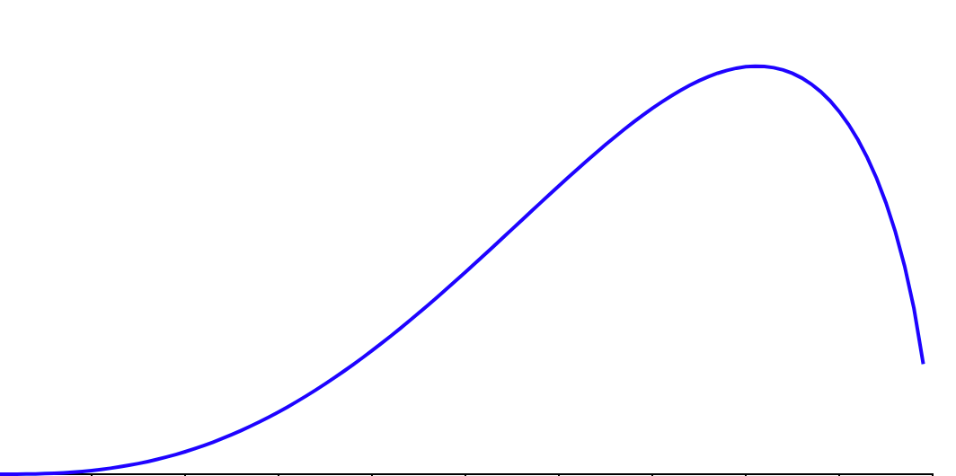
Notes:
Now we encounter the same scenario, however the cat was with us when we heard the mug broke, letting the prior be strongly at the dog. We also found a cat paw printnear the mug, giving strong evidence the cat. The belief now shifts. However, because we had strong priors, we still strongly believe the dog did it.

Slide 29
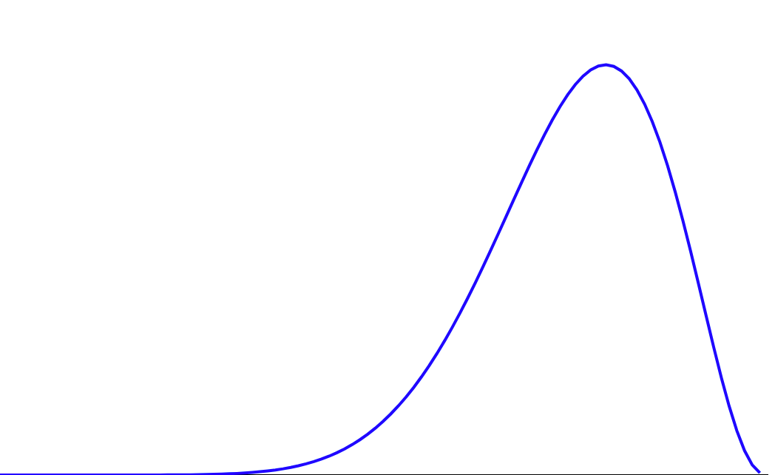
Area under the curve totals to 1, as probabilities do, and it quantifies our belief
Notes:
Now we encounter the same scenario, however the cat was with us when we heard the mug broke, letting the prior be strongly at the dog. We also found a cat paw printnear the mug, giving strong evidence the cat. The belief now shifts. However, because we had strong priors, we still strongly believe the dog did it.

Slide 30
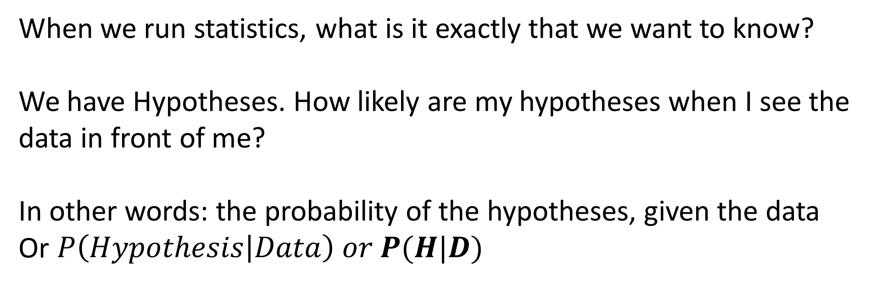
So what do we want to know in Statistics?
When we run statistics, what is it exactly that we want to know?
We have Hypotheses. How likely are my hypotheses when I see the data in front of me?
In other words: the probability of the hypotheses, given the data
Or $P\left(Hypothesis | Data\right) or P(H|D)$
Prior
Belief

Slide 31
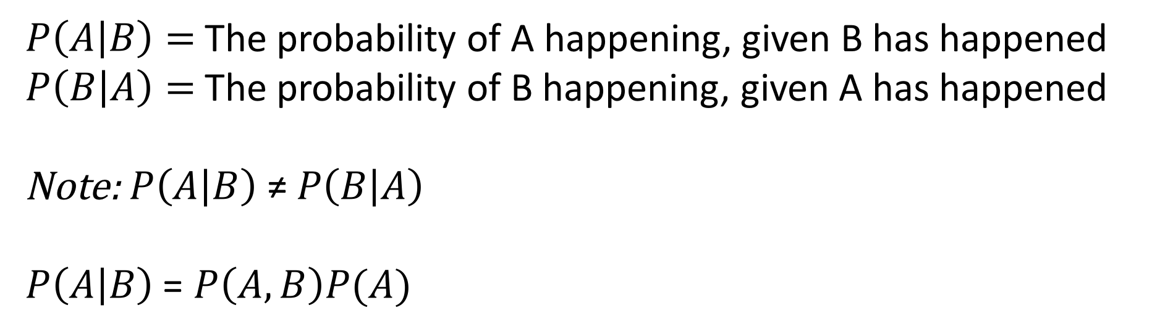
Conditional Probability
$P\left(A | B\right)=$The probability of A happening, given B has happened
$P\left(B | A\right)=$The probability of B happening, given A has happened
Note: $P\left(A | B\right) \text{≠} P\left(B | A\right)$
$P\left(A | B\right)$ = $P\left(A,B\right)P(A)$
Prior
Belief

Slide 32
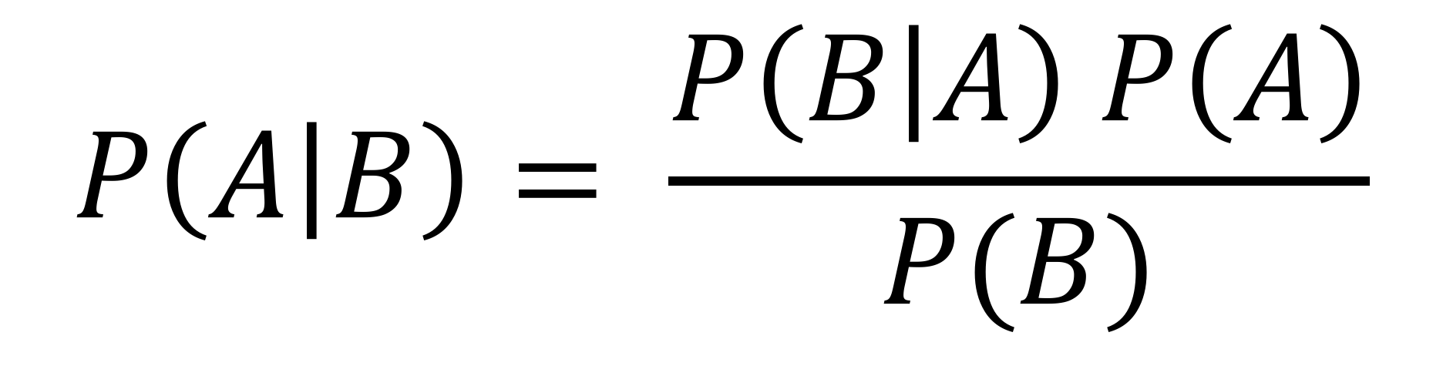
Bayes Formula
Luckily, we have a formula for calculating conditional probabilities together:
Prior
Belief
$$P\left(A | B\right)= \frac{P\left(B | A\right) P\left(A\right)}{P(B)}$$

Slide 33
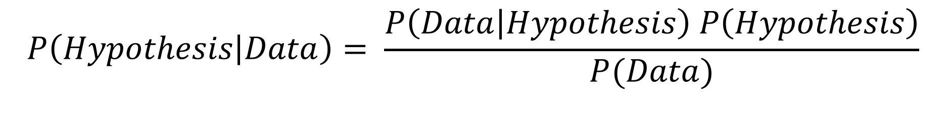
Bayes Formula
Prior
Belief
$$P\left(Hypothesis | Data\right)= \frac{P\left(Data | Hypothesis\right) P\left(Hypothesis\right)}{P(Data)}$$

Slide 34

Bayes Formula
Prior
Belief
$$Posterior Belief= \frac{Likelihood . Prior Belief}{Normalising Factor}$$

Slide 35
Imagine you took a test for a disease that only occurs in 0.1% of the population, and the test if 99% accurate. If it tested positive, how likely do you have the disease?

Slide 36

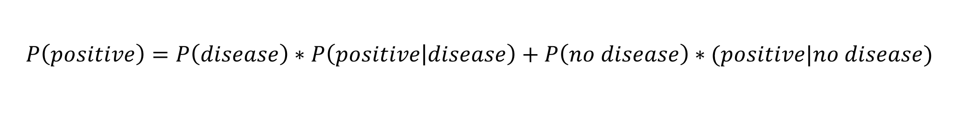


Bayes Formula Applied – Base Rate Fallacy
Imagine you took a test for a disease that only occurs in 0.1% (or 0.001) of the population, and the test if 99% accurate. If it tested positive, how likely do you have the disease?
$$P\left(disease | positive\right)= \frac{P\left(positive | disease\right) P\left(disease\right)}{P(positive)}$$
$$P\left(positive\right)=P\left(disease\right)∗P\left(positive | disease\right)+P\left(no disease\right)∗(positive|no disease)$$
$$P\left(positive\right)=0.001∗0.99+0.999∗.01=0.01098$$
$$Prior Probability of having the disease= P\left(disease\right)=0.001$$
$$P\left(positive|disease\right)=0.99$$
$$P\left(disease|positive\right)=0.09 or 9\%$$
Notes:
So now that you have p(positive), can you calculate the outcome?

Slide 37

Bayes Formula Applied – Base Rate Fallacy
$$P\left(disease | positive\right)= \frac{P\left(positive | disease\right) P\left(disease\right)}{P(positive)}$$
Imagine you took a test for a disease that only occurs in 0.1% (or 0.001) of the population, and the test if 99% accurate. If it tested positive, how likely do you have the disease?
1000 people
1 has the disease, 999 people don’t
From the other 999 people, 1% would be falsely identified as having the disease, which is about 10 people
So we have 1 true positive, and 10 false positives, which 1/11 which is about 9%

Slide 38


Bayes Formula Applied – Second Opinion
Imagine you took a test for a disease that only occurs in 0.1% (or 0.001) of the population, and the test if 99% accurate. If it tested positive, how likely do you have the disease?
$$P\left(disease | positive\right)= \frac{P\left(positive | disease\right) P\left(disease\right)}{P(positive)}$$
$$P\left(positive\right)=P\left(disease\right)∗P\left(positive | disease\right)+P\left(no disease\right)∗(positive|no disease)$$
$$P\left(positive\right)=0.09∗0.99+0.91∗.01=0.0.0982$$
$$Prior Probability of having the disease= P\left(disease\right)=0.09$$
$$P\left(positive|disease\right)=0.99$$
$$P\left(disease|positive\right)=0.907 or 91\%$$
Notes:
Updating our current belief

Slide 39
Part 3: Bayesian Inference
Introduction to Bayesian Analysis

Slide 40
So what do we use instead of p-values?
In Bayesian Hypothesis Testing we use Bayes Factors which quantify support or evidence for the null or the alternative hypothesis.

Slide 41
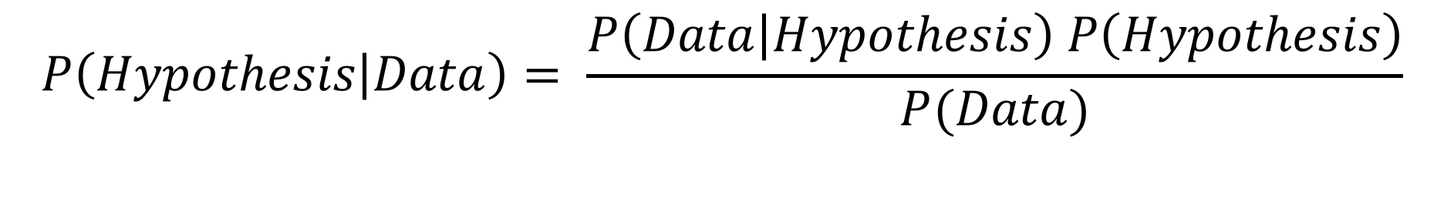

Bayes Formula
$$P\left(Hypothesis | Data\right)= \frac{P\left(Data | Hypothesis\right) P\left(Hypothesis\right)}{P(Data)}$$
Prior
Belief
$$P\left(H | D\right)= \frac{P\left(D | H\right) P\left(H\right)}{P(D)}$$
Notes:
So remember the Bayes Formula, we know that often there are more than one hypotheses or models that we can use to explain our data. Likelihood is how well do the

Slide 42
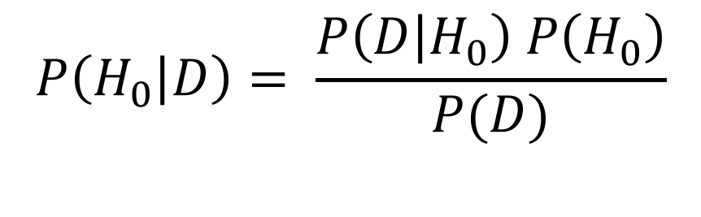
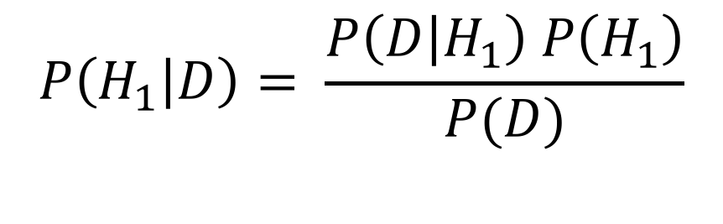
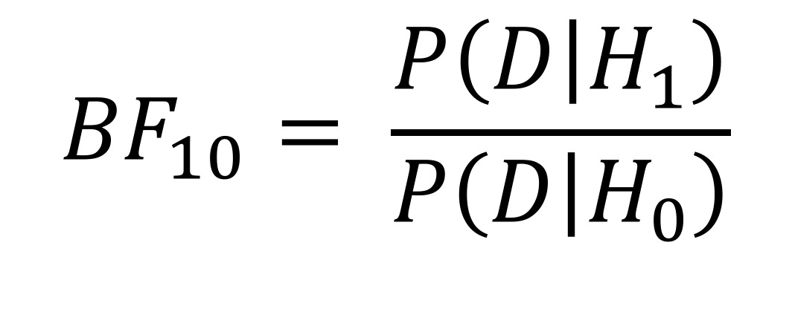
Bayes Formula
$$P\left(H_{0} | D\right)= \frac{P\left(D | H_{0}\right) P\left(H_{0}\right)}{P(D)}$$
$$P\left(H_{1} | D\right)= \frac{P\left(D | H_{1}\right) P\left(H_{1}\right)}{P(D)}$$
Prior
Belief
$${BF}_{10}= \frac{P\left(D | H_{1}\right)}{P\left(D | H_{0}\right)}$$
Note that in frequentist analyses, we don’t normally compare models, we ’accept’ the alternative when we reject the null
Notes:
So the likelihood is how well the data fit the hypothesis

Slide 43
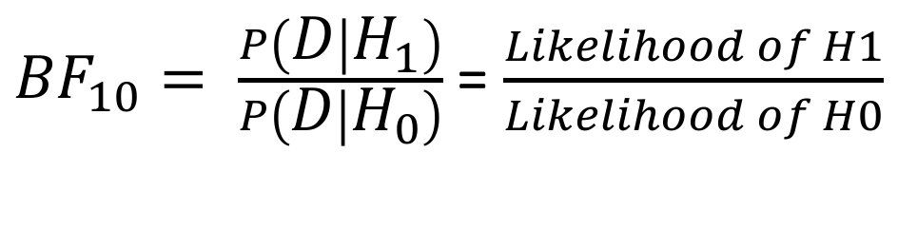
Bayes Factor
${BF}_{10}= \frac{P\left(D | H_{1}\right)}{P\left(D | H_{0}\right)}$ = $\frac{Likelihood of H1}{Likelihood of H0}$
Prior
Belief
After seeing the data, how likely is one model compared to another?
Notes:
So the likelihood is how well the data fit the hypothesis

Slide 44
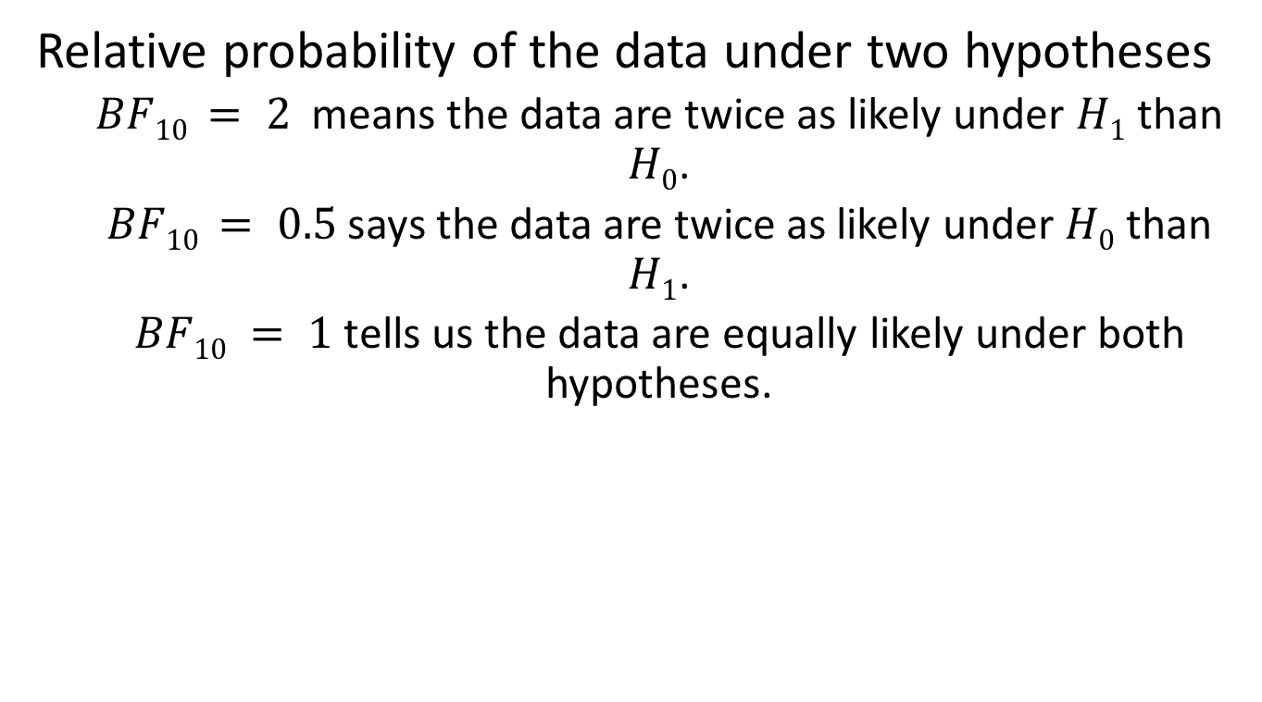
Bayes Factor
Relative probability of the data under two hypotheses
$BF10 = 2$means the data are twice as likely under $H1$ than $H0$.
$BF10 = 0.5$says the data are twice as likely under $H0$ than $H1$.
$BF10 = 1$ tells us the data are equally likely under both hypotheses.

Slide 45
Jeffrey’s Scale
IF B₁₀ IS… | THEN YOU HAVE…
> 100 | Extreme evidence for H₁
30 – 100 | Very strong evidence for H₁
10 – 30 | Strong evidence for H₁
3 – 10 | Moderate evidence for H₁
1 – 3 | Anecdotal evidence for H₁
1 | No evidence
1/3 – 1 | Anecdotal evidence for H₁
1/3 – 1/10 | Moderate evidence for H₁
1/10 – 1/30 | Strong evidence for H₁
1/30 – 1/100 | Very strong evidence for H₁
< 1/100 | Extreme evidence for H₁
(Jeffreys, 1961; Lee & Wagenmakers, 2013)

Slide 46
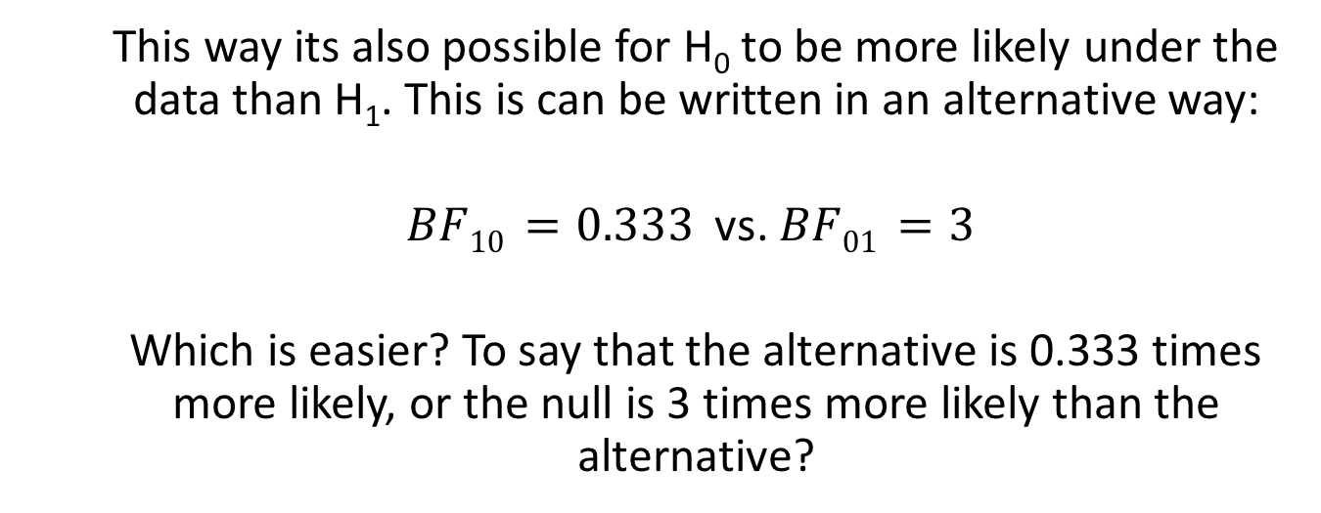
Bayes Factor
This way its also possible for H₀ to be more likely under the data than H₁. This is can be written in an alternative way:
$BF10 =0.333$ vs. $BF01 =3$
Which is easier? To say that the alternative is 0.333 times more likely, or the null is 3 times more likely than the alternative?

Slide 47
Bayes Factor
So instead of saying that there was a significant difference between X and Y,
We can now say: The analysis revealed that the alternative is X times more likely than the null,

Slide 48
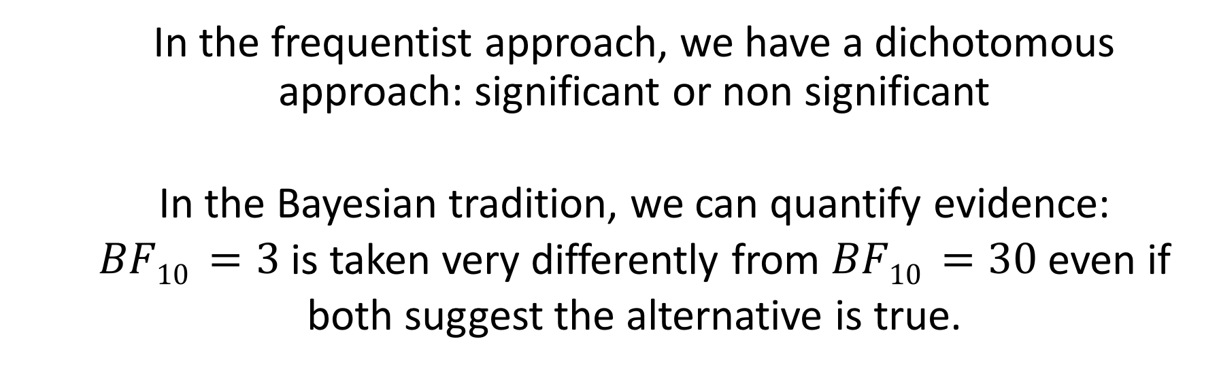
Bayes Factor
In the frequentist approach, we have a dichotomous approach: significant or non significant
In the Bayesian tradition, we can quantify evidence:
$BF10 =3$ is taken very differently from $BF10 =30$ even if
both suggest the alternative is true.

Slide 49
Part 4: Bayesian Application
Introduction to Bayesian Analysis

Slide 50
JASP: Jeffrey’s Awesome Statistics Program
Interfaces with R
Has a ton of new features

Slide 51
The JASP website made this, not me

Slide 52
Turning wheels
Open ‘Kitchen Rolls’ data set (Examples)
Clockwise rotation of paper towel induces Openness to future and novelty
Pre-registered adversarial collaboration (Wagenmakers et al., 2015)

Slide 53
Analysis
Does turning direction
‘Rotation’ variable
affect scores on openness survey
‘mean_NEO’ variable
Independent samples t-test

Slide 54
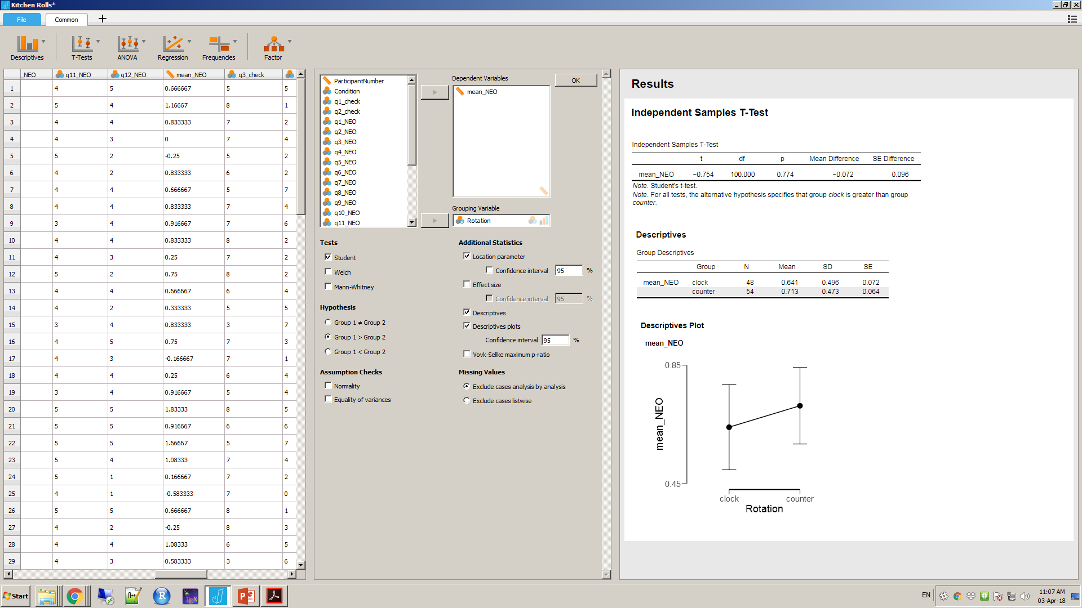
Frequentist Analysis

Slide 55
Frequentist Analysis
Sample size wasn’t defined in advance
Test 40 participants
Check statistics
Test until either some condition met or 100 participants
No power analysis in advance, so difficult to interpret

Slide 56
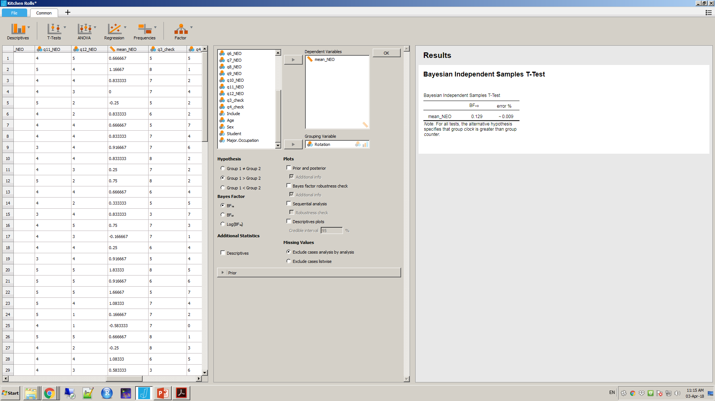
Bayesian Analysis

Slide 57
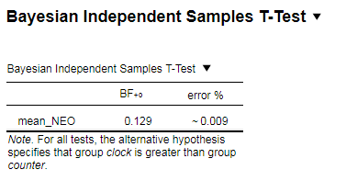
Bayes Factor

Slide 58
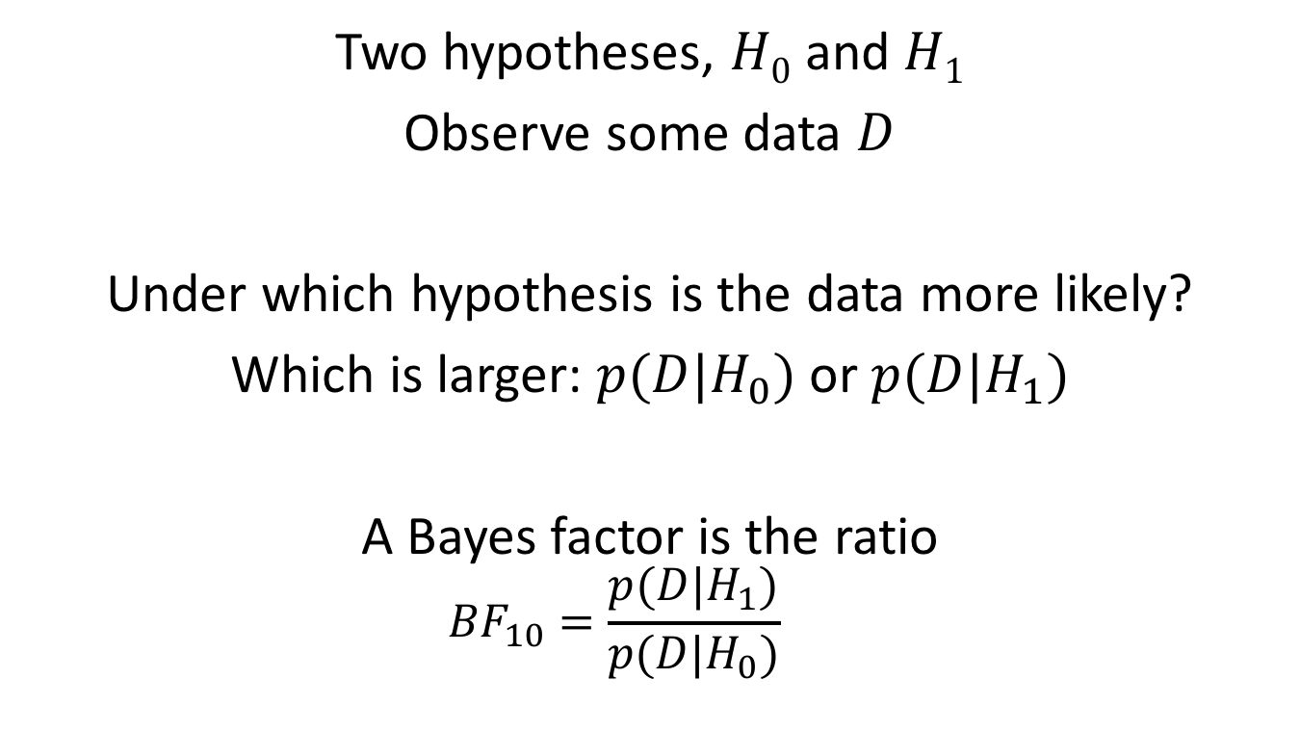
Hypothesis Testing
Two hypotheses, $H0$ and $H1$
Observe some data $D$
Under which hypothesis is the data more likely?
Which is larger: $p(D|H_{0})$ or $p(D|H_{1})$
A Bayes factor is the ratio
$${BF}_{10}=\frac{p(D|H_{1})}{p(D|H_{0})}$$

Slide 59
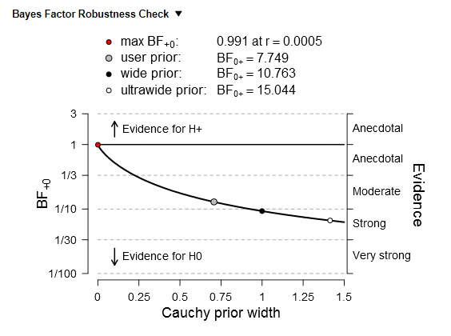
Robustness Check

Slide 60
Priors
The alternative hypothesis is often referred to as the prior
Clearly, it has an influence on Bayes factor
Often a criticism leveled at Bayesian statistics
Priors define the alternative hypothesis
Of course the relative evidence for one hypothesis depends on the alternative hypothesis
Bayesian = H0 vs. H1, Frequentist = H0 vs. Anything else

Slide 61
Thank you!
Collaborators:
Dr. Steven B. Most
Dr. Chris Donkin
Scientia Prof. Richard Bryant
Assoc Prof. Mike Le Pelley
Dr. Poppy Watson
Prof. Mary Peterson
Prof. Colin MacLeod
Dr. Lies Notebaert
Dr. Patrick Clarke
Dr. Rob Taylor
Dr. Emmanouil Konstanditis
Adrian Walker
Hanbit Cho
Arthur Kary

